Slide 1
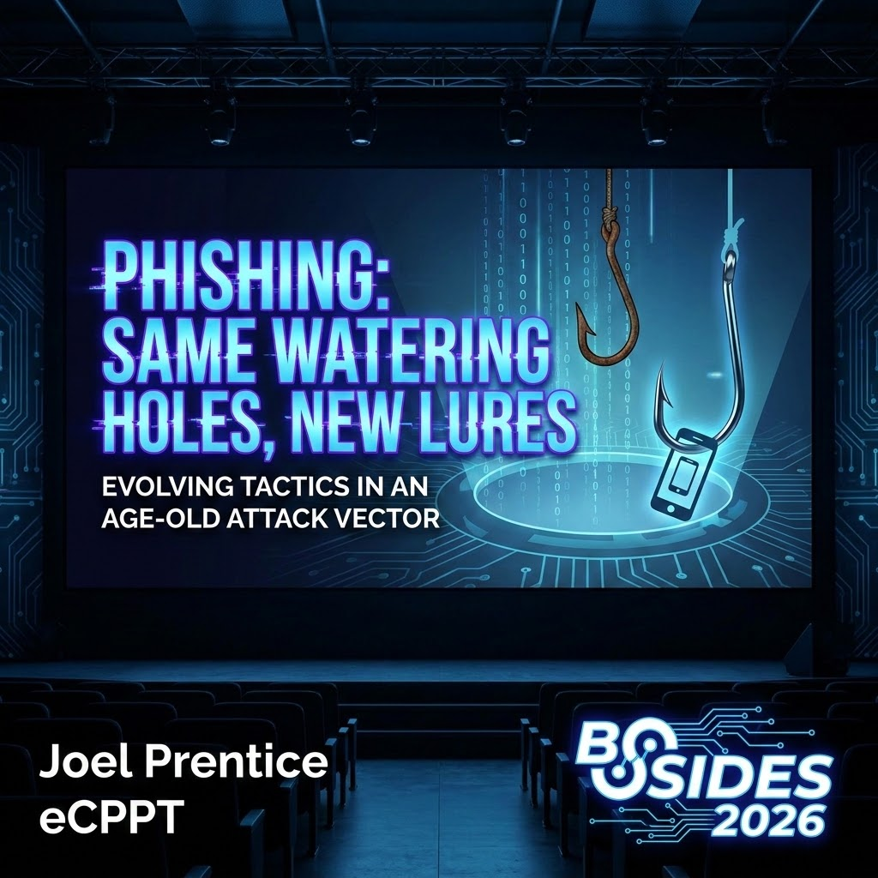
Notes:
0:00 – 1:05 | The Autopilot Morning:
"It’s 8:15 AM on a Wednesday. You know that window—you’ve just sat down, the laptop is docked, and you’re in that 'autopilot' mode of triaging emails before the meetings start to stack up. At a regional energy utility right here in Pennsylvania, an engineer named Dave is looking for a way to get ahead of his To-Do list. Dave isn't looking for a fight. He’s not looking for a 'threat.' He’s just looking to clear his queue. And that’s when he sees it. An Outlook notification. It’s marked 'Urgent,' and the subject line reads: ‘Harrisburg Infrastructure Assessment – Action Required.’ Now, Dave doesn't hesitate. Why would he? He was working on the Harrisburg project yesterday. The email is from a vendor he’s known for five years. Everything about this feels like a normal part of a productive morning."
1:05 – 2:10 | The "Slow-Motion" Click:
Dave clicks the link. He doesn't get a 'Warning: Malicious Site' banner. His browser doesn't stutter. He’s taken to a SharePoint login page that is... perfect. The branding, the fonts, the 'Privacy' links at the bottom—it’s all there. He types his username. He types his password. He’s not being 'tricked' by a fake site; he is looking at a live-stream of the real Microsoft. And then, the push notification hits his phone. Ping. It’s muscle memory. Dave doesn't even look away from his monitor; he just reaches down, taps 'Approve,' and goes back to his coffee. The document opens—a 40-page PDF on infrastructure. Dave spends ten minutes reviewing it, closes the tab, and moves on to his next task."
2:10 – 3:08 | The Forensic Reveal & The Metaphor:
"But while Dave is reading that PDF, something is happening in the memory of a proxy server. That proxy didn't just 'pass him through.' It cloned him. By 9:30 AM, Dave still has his password, but the attacker has Dave’s identity. This is what I call the 'Invisible Valet.' Think about how a valet works. He doesn't want your keys; he wants your car. He stands between you and the restaurant. You hand him your car, he drives it to the real valet, gets the real claim ticket, and hands it back to you. You walk into dinner thinking your car is safe. Meanwhile, the 'Invisible Valet' has already made a copy of your 'All-Access' pass and is driving your car out of the lot."
3:08 – 3:43 | The Authority Bridge:
"I’m Joel Prentice. I’m a Cybersecurity Engineer, and I spend my days looking at the gaps between our 'Padlocks' and our reality. Today, we are going to go under the hood of the 'Invisible Valet.' We are going to dismantle the engine of the proxy, packet by packet, and I’m going to show you why in 2026, the 'Same Watering Holes' we use every day—SharePoint, Teams, and Outlook—have been turned into the perfect delivery systems for a new breed of lure."
3:43 – 3:58 | [Transition]:
"So, Dave’s car is gone. His identity is cloned. But how? It’s not because our encryption is broken. It’s because our protocols have a massive, structural blind spot."

Slide 2
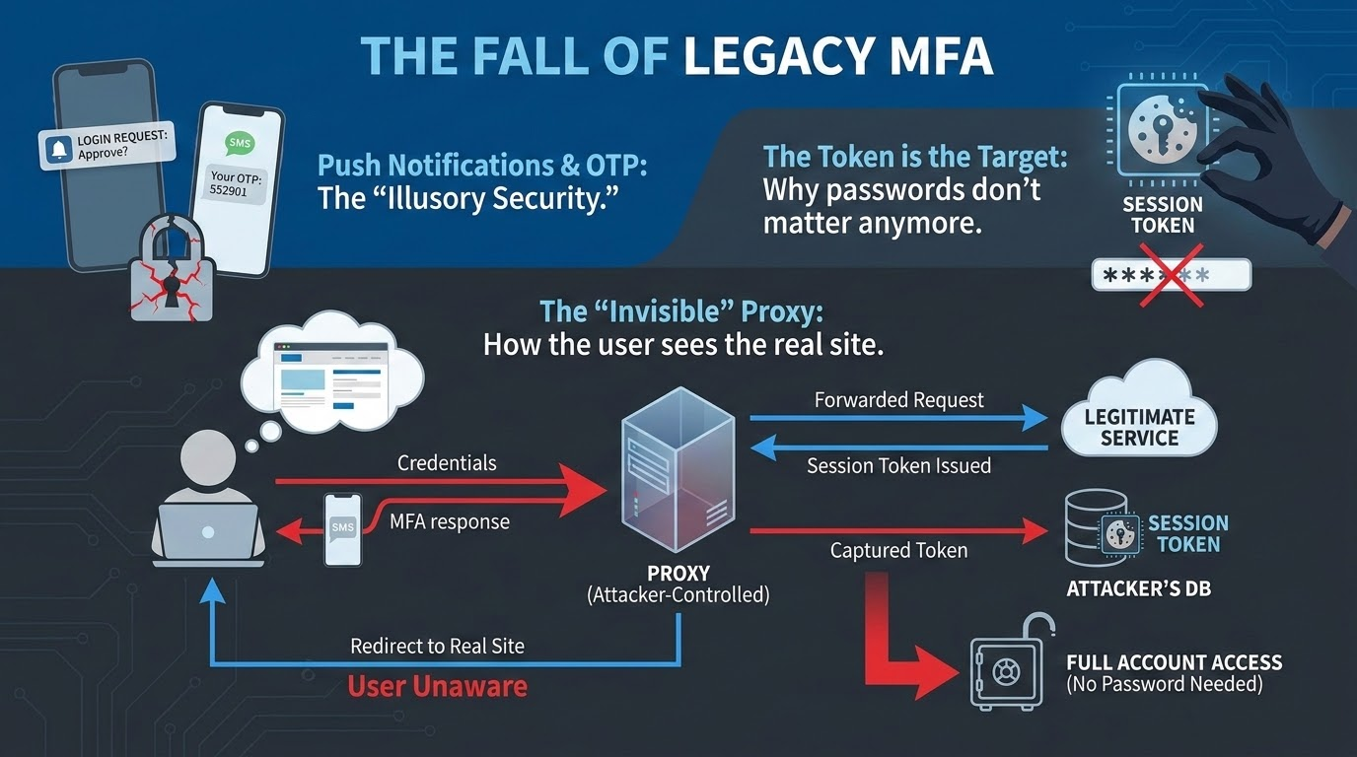
Notes:
3:58 – 4:30 | The Transition: The Protocol Blind Spot
We’ve spent a decade telling our boards that MFA is the finish line—that if we just get to 100% enrollment, the game is over. But in 2026, we have to admit that compliance is just the floor. We are building massive security stacks on top of a foundation that is fundamentally 'context-blind.' Dave did everything we taught him to do, but the physics of the connection were rigged against him from the start.
4:30 – 5:54 | The $20 Bill & The Hunter’s Prize
At the heart of this is how we handle identity. Most MFA we use—Push, SMS, or those 6-digit codes—ends with the server handing the user a Bearer Token. I want you to think of this like a $20 bill. If I drop this bill in the hallway here at the PA Farm Show complex and you pick it up, it’s yours. The guy selling coffee doesn't care who I am; he just cares that you’re holding the cash.
In a Microsoft environment, the proxy is hunting for one specific piece of 'digital cash': the ESTSAUTHPERSISTENT cookie. This isn't just a random string; it’s a signed blob that tells the cloud: 'This user has already proven they have the password and passed the MFA gate.' To an attacker, this cookie is worth more than the password. Because it isn't 'Sender-Constrained,' the attacker doesn't need to 'hack' anything—they just have to 'bear' the token. They pluck it out of the air in Pennsylvania and spend it in a data center halfway across the world. To the server, that’s not a hack; that’s just a guy with a twenty.
5:54 – 6:48 | The Two-Channel Forensic Gap
Now, why didn't Dave's phone warn him? It’s the gap between the Front and Back channels. Dave lives in the 'Front-Channel'—the browser. But the real 'handshake' happens in the 'Back-Channel' between the server and the Identity Provider. When that push notification hit Dave’s phone at 8:15 AM, it asked: 'Are you trying to sign in?' It’s a simple binary question. It didn't mention the proxy. It didn't mention that the request was routed through a malicious middleman. The phone has zero cryptographic proof of the Origin URL. We are asking our employees to make high-stakes forensic decisions based on a 'Yes/No' button that is functionally blind to the network metadata.
6:48 – 9:32 | The Persistence Trap & The Resident Proxy
And then we have the Persistence Trap. We’ve all set those 14-day session windows because we don't want to get yelled at about 'MFA Fatigue.' Attackers love our convenience. You might think your 'Impossible Travel' logic would catch this, but the adversary has evolved. They aren't 'spending' that digital cash from a known-bad data center. They are using Residential Proxy Networks, routing that stolen cookie through a hijacked home router in a neighborhood three miles away from your office. To your logs, it doesn't look like an attack. It just looks like Dave decided to check his email from a Starbucks down the street. Dave’s 'one-second' mistake becomes the attacker’s 'month-long' residency.
Think about the math of that. We spend millions on EDR to catch a process that runs for three seconds, but we’re willing to let a stolen session cookie live for 1,209,600 seconds. "Think about what that number actually represents: 1,209,600 seconds. As security teams, we deploy Endpoint Detection and Response (EDR) platforms to alert on a malicious PowerShell process executing in three seconds. We configure our SIEMs to fire rules if an anomalous service account behaves weirdly for a minute. Yet, the foundational protocol architecture we rely on is completely content to let a single, stolen, unconstrained string of cryptographic text walk out the door and maintain total residency for over a million seconds without a second thought.
[Directly challenge the audience]
Let’s do a quick reality check here. If a threat actor exfiltrates a machine's NTDS.dit file or dumps local LSASS memory, your SOC goes into a tier-1 lockdown. But if they silently pickpocket an active ESTSAUTHPERSISTENT cookie from an unmanaged mobile browser, it bypasses the entire traditional triage pipeline because the server views it as an entirely legitimate resumption of a convenient, long-lived session. That asymmetry is exactly why the adversary stopped trying to crack the perimeter and started waiting at the watering holes.“
9:32 – 9:52 | The Closing Hand-off [Pause. Scan the room.]
"If our foundation is this shaky, we have to ask: how does the adversary actually set up the heist? How do they build a machine that can live-edit Dave's reality without him seeing a single glitch? To understand that, we have to go under the hood of the engine itself."

Slide 3
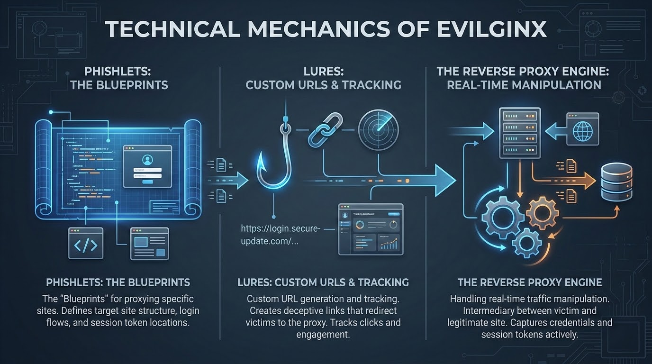
Notes:
9:52 – 10:39 | The Myth vs. The Reality
When people hear 'phishing site,' they usually picture a static, fake page hosted on a shady server. They think if they look closely enough at the font or the logo, they'll spot the fake. But tools like Evilginx have changed the game. This isn't a 'copy' of Microsoft; it’s a surgical, live-streamed relay. It isn't hosting anything. It’s sitting in the middle, acting as a translator between Dave and the real Microsoft servers. If Microsoft changes their background image for a holiday at 2:00 PM, the phishing site changes at 2:00:01 PM. It is a perfect, real-time reflection.
10:39 – 11:46 | The Search & Replace Machine
So how does it keep Dave from noticing he’s on a different domain? It uses what I call the 'Search and Replace' engine, powered by the NGINX sub_filter module. As the real data packets fly from Microsoft toward Dave's browser, the proxy catches them in mid-air. It scans the code for every mention of the real domain—login.microsoft.com—and live-edits it to point back to the proxy’s domain. It’s rewriting the fabric of the session on the fly. When Dave clicks 'Sign In,' the proxy catches that request, strips out Dave's info, forwards it to the real Microsoft, and then catches Microsoft's response to continue the lie. It’s a high-speed game of 'Keep Away' where the user never sees the ball.
11:46 – 12:24 | Stripping the Armor (The Security Header Bypass)
But wait—modern browsers have armor, right? We have Content Security Policy (CSP) and X-Frame-Options specifically designed to stop this. This is where the proxy gets surgical. As those security headers fly through the proxy, it doesn't try to bypass them; it just deletes them. It identifies the instructions that tell the browser 'Only trust Microsoft' and simply strips them out of the packet. By the time that data reaches Dave’s laptop, the browser is functionally blind. It’s not that the browser failed; it’s that the instructions on how to protect itself were stolen before they could be read.
12:24 – 13:16 | The Termination Point & The Plaintext Prize
Here is the most critical technical point: the proxy is the TLS Termination Point. We’ve spent years telling people 'Look for the padlock,' but that padlock only means the tunnel is encrypted. In this attack, there are two tunnels: one from Dave to the Proxy, and one from the Proxy to Microsoft. Because the proxy owns the keys to both, it is the only place in the world where that traffic is decrypted. For a fraction of a millisecond inside the proxy’s RAM, Dave’s password and that ESTSAUTHPERSISTENT cookie exist in plaintext. The attacker isn't 'cracking' encryption; they are just a legitimate end-point of a hijacked conversation.
13:16 – 13:49 | Transition
[Step toward the center of the stage. Pause for 3 seconds.]
Now, think about what we just unpacked. A machine running this aggressively—literally ripping SSL sessions apart in mid-air, stripping out core security headers, and rewriting domain strings on the fly—should be blindingly obvious. It should be screaming 'malicious' to every automated cloud sandbox and threat intel feed on the planet.
So why isn't your multi-billion dollar enterprise security stack catching it?
It’s because the adversary faced a massive engineering problem: defense-in-depth security scanners. To survive, they had to build a protective layer around their proxy. They built an adaptive, identity-aware firewall whose sole job is to interrogate every single inbound connection before letting them anywhere near the phishing engine.
[Click to Slide 4]

Slide 4
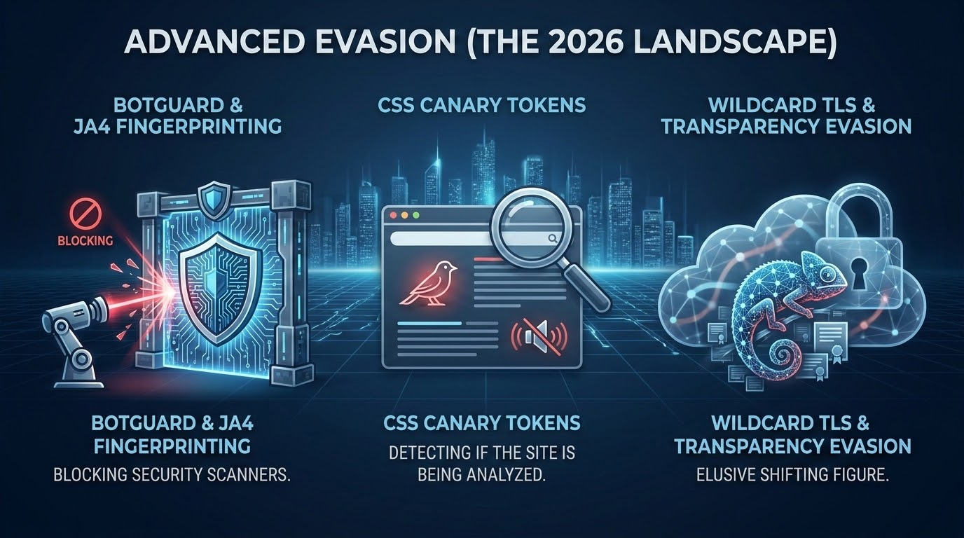
Notes:
13:49 - 14:48 | The Identity-Aware Evasion
They built a digital bouncer at the door.
The enemy knows exactly what we are looking for. They maintain dynamic, updated registries of every known IP address belonging to Microsoft, Google, and every major security vendor sitting in this building. If an automated corporate sandbox or an email gateway crawler attempts to inspect that URL, the bouncer immediately executes a 'Silent Fail'. It serves up a generic 404 error, or it seamlessly redirects the traffic to a completely legitimate destination like the real Google landing page. To your SOC, the link looks dead, or it looks like a user misclick. But the exact millisecond a real human being clicking from a legitimate Pennsylvania egress hits that web server? The bouncer steps aside, and the door opens wide.
14:48 - 15:26 | The Digital Accent (JA4 Fingerprinting)
But they go deeper than just IP filtering. They look at your Digital Accent. Every browser—and every bot—leaves a unique signature during the TLS handshake. We used to use JA3, but the gold standard now is JA4.
[Point to the JA4 diagram]
Security scanners have very 'robotic' accents. They use specific cipher suites in a specific order that no human on a standard Chrome browser would ever use. The proxy bouncer inspects this signature before a single byte of the webpage is even served. If the fingerprint doesn't look like a real person on a real device, the trap stays hidden. We are fighting an enemy that can tell the difference between a forensic tool and a victim in a fraction of a second.
15:26 - 18:33 | Behavioral Gating: The Humanity Test
Even if you get past the IP filter and the fingerprinting, you hit the Humanity Test. Modern proxies use Behavioral Gating. When the page first loads, the 'Sign-In' form isn't even in the code. The script is sitting there, waiting. It’s looking for non-linear mouse movement. It’s looking for a window resize. It’s looking for a scroll.
If a sandbox takes a screenshot at 'Time Zero' to analyze the page, it just sees a blank white screen. Because the bot doesn't 'move' like a person, the phishing logic never triggers. The bouncer only hands over the keys to the kingdom when it's convinced there’s a heartbeat on the other end of the wire.
I want to highlight a trap for your SOC teams here. How many times has a user reported a link, your analyst clicks it in a sandbox, sees a blank white page, and closes the ticket as 'False Positive' or 'Broken Link'? That is exactly what the bouncer wants. We have to train our analysts that a '404' or a 'Blank Page' on a reported phish isn't a sign of safety—it’s a sign that the adversary recognized your forensic signature and went dark.
Let's pull back the curtain on how your SOC analysts interact with this evasion. A user submits a suspicious link via an Outlook reporting add-in. The automated mail filter spins up a cloud sandbox, loads the URL, and takes a screenshot at 'Time Zero.' Because there's no DOM rendering without interactive human mouse pathing or window scaling , the bot captures a pristine white frame and flags the URL as harmless.
Then, a tier-1 analyst manually reviews the escalation queue. They click the link inside their isolated environment. The adversary's bouncer scans the TLS fingerprint, notes a robotic accent or a data-center IP pool , and issues a hard 404 or a redirect to an innocent landing page. The analyst logs the ticket as a 'Broken Link' or a user error and closes it.
We have to fundamentally retrain our security operations teams to realize that a 404 error, an infinite loading spinner, or a blank page on a user-reported email is no longer a sigh of relief. In 2026, it is a high-confidence indicator of compromise. It means the adversary recognized your forensic signature, slammed the blast doors shut to hide their engine, and kept the trap open exclusively for the victim.
18:33 - 19:28 | Laundering the IP: Residential Proxies
They route these sessions through hijacked home routers three miles from your office. To your automated 'Impossible Travel' alerts, this traffic looks perfectly normal. The bouncer hasn’t just checked the ID; he's ensured the attacker is wearing the exact same local uniform as your employees.
So the bouncer is guarding the door, the engine is running, and the trap is completely invisible to your infrastructure. But a trap is useless if nobody walks through it. The adversary still faces one massive hurdle: they have to force a human being to step inside.
19:28 - 19:56 | Transition to Slide 5
[Step to the side of the stage. Shift your tone to focus on strategy.]
They know that if they send a malicious link to Dave’s corporate-managed laptop, they risk running into EDR memory inspection, DNS blocklists, or secure email gateways. They don't want to fight a rigged match on your home turf.
So in 2026, the modern adversary executes a brilliant tactical pivot. They move the entire battlefield away from the corporate perimeter.
[Click to Slide 5]

Slide 5
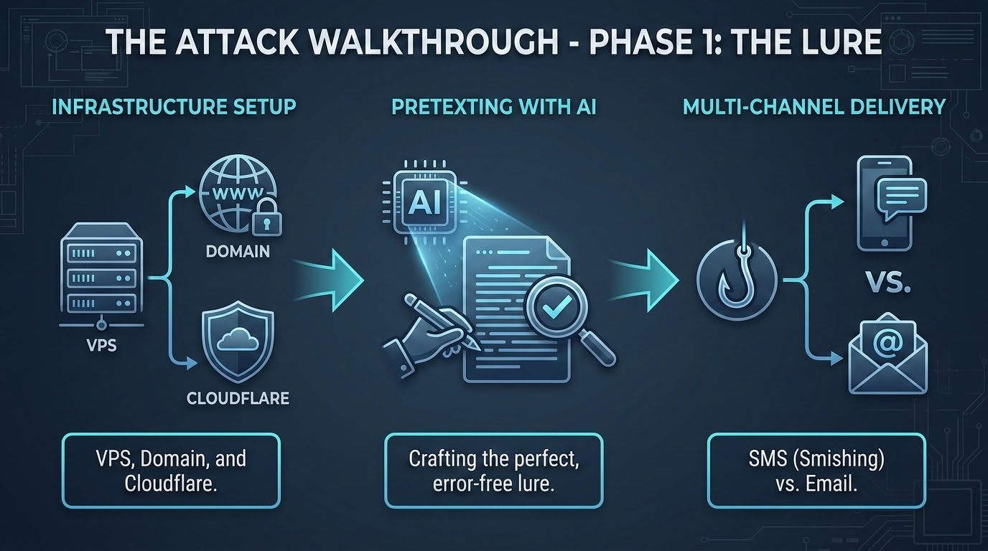
Notes:
The Lure & The Mobile Pivot (7:00)
They go straight for the pocket.
20:04 – 20:38 | The Path of Least Resistance
They target the unmanaged mobile device. They want to shift the conflict from a professional ring where you have a referee and a camera, to a dark back alley where your security team is completely blind. This is the 'Pocket Pivot.' The adversary plays on our collective psychological attachment to our phones—because they know that the second an employee interacts with corporate data on a six-inch personal screen, their security posture completely shifts from skeptical professional to distracted consumer.
20:38 – 21:22 | The Black Box of Quishing (QR Phishing)
Enter Quishing. A QR code is a total 'black box' to your email security gateway. Most filters just see an image. But for the user, it’s a call to action. When Dave scans a code in a PDF or on a breakroom poster, he’s just bypassed your entire defensive stack. He’s on his personal iPhone now. There is no EDR there. There is no corporate VPN. And on that cramped mobile screen, the UI hides the malicious URL. We’ve allowed the attacker to move the battle to a device where the 'Padlock' is the only thing the user sees, and as we know, the padlock is a lie.
21:22 – 22:24 | Trust Laundering & AI Context
They aren't using bad-site.com. They use Open Redirects on domains you trust—LinkedIn, Google, or Microsoft. Your filter sees 'LinkedIn' and gives it a green light. The user sees 'LinkedIn' and feels safe. But after the click, that trusted domain silently 'launders' the link through three hops until they land at the proxy.
[Tone shift: Serious]
And with LLMs, the 'Cringe Factor' is gone. They aren't sending generic spam. They’ve scraped Dave’s LinkedIn and his company’s public contracts. The lure says: 'Hey Dave, I’m finalizing that Harrisburg assessment—can you check these permissions?' It’s not a phish; it’s a high-fidelity impersonation. We’re asking users to doubt their own boss, and in a high-pressure morning, that is a losing bet."
22:24 – 22:44 Transition to slide 6
Dave is now looking at an email that sounds like his boss, referencing a project he’s actually working on, delivered to a device he trusts. The psychological bridge has been crossed. He’s scanning the code. He’s clicking the link.
[Click to Slide 6]

Slide 6
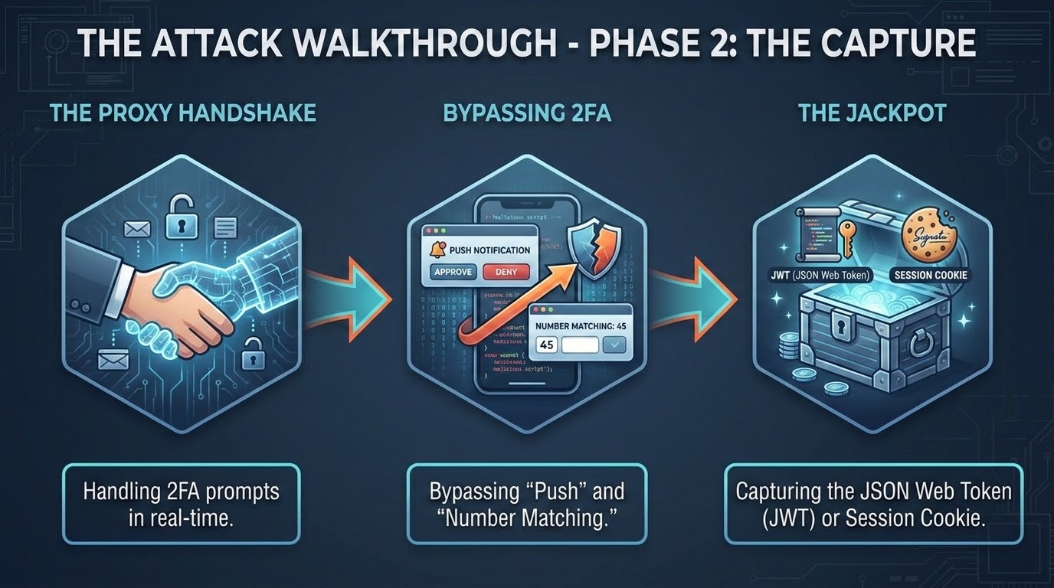
Notes:
22:44 – 22:58 | Transition
At this exact moment, the 'Invisible Valet' steps out of the shadows.
We’re about to watch the actual theft happen in real-time. This is the Phase 2 'Capture Dance.
22:58 – 23:38 | The Synchronized Handshake
The user is on the site. They’ve scanned the code. To them, it looks like a normal Wednesday. But behind the scenes, we’re performing the 'Capture Dance.' As Dave types his username, the proxy mirrors those keystrokes to the real Microsoft server in milliseconds. This is a real-time, synchronized handshake. When Microsoft issues the MFA challenge, the proxy just passes it through to Dave’s phone. Dave taps 'Approve,' thinking he’s logging in. He didn't just authorize himself; he authorized the Valet.
23:38 – 24:11 | Plucking the Golden Ticket
Because our proxy is the TLS Termination Point, it has a front-row seat. Once that MFA is cleared, Microsoft sends back the prize: the session cookies. The proxy plucks the ESTSAUTHPERSISTENT cookie out of the HTTP header before it ever reaches Dave. This is the 'Golden Ticket.' It’s the proof that the password and the MFA were successful. The proxy doesn't need to 'crack' anything; it just catches the ball that Microsoft threw.
24:11 – 25:00 | The Clean Hand-off
To keep the illusion alive, the proxy executes a seamless, transparent hand-off. It silently forwards Dave straight to the real SharePoint file he was expecting. Dave thinks to himself, 'Okay, that was a slightly weird login delay,' but he’s in. He closes the browser tab, grabs his notebook, and walks into his 8:30 AM meeting completely oblivious.
Meanwhile, back on the attacker’s command dashboard, a notification pings. They don't have Dave's password—and frankly, they don't want it. What they have is a fully functional, live clone of Dave’s cloud identity.“
25:00 – 25:48 | Transition to slide 7
Now, in a traditional corporate security model, we have a standard playbook for this. The alert fires, the SOC realizes Dave's identity might be compromised, and the remediation team immediately pulls the emergency brake: we trigger an enterprise-wide password reset. We patch the hole, we consider the incident closed, and we move on to the next ticket.
[Slowly shake your head slightly.]
But we are standing here in 2026. And in the modern enterprise cloud, assuming a password reset is a silver bullet is not just a mistake—it is a fundamentally dangerous assumption.
[Step toward the center of the stage. Shake your head slightly.]
[Click to Slide 7]

Slide 7
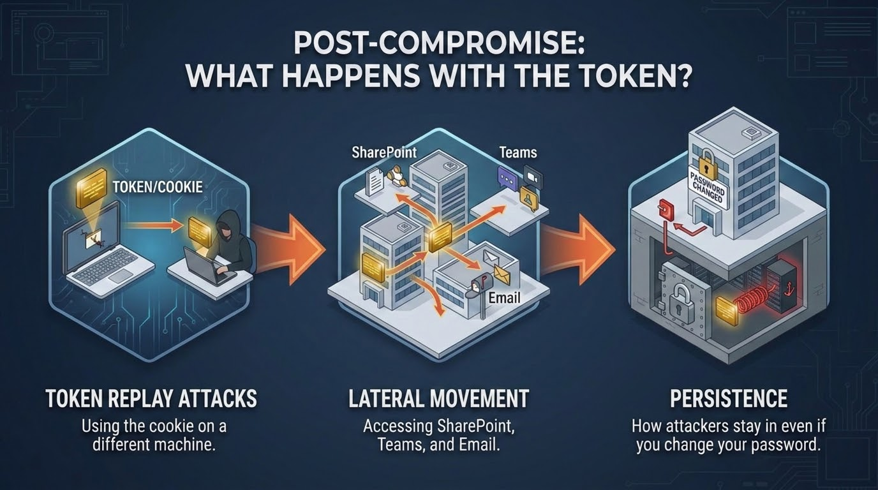
Notes:
25:48 – 25:57 | Transition
Let's look under the hood of why the traditional 'Kill Switch' you’ve been relying on for a decade is completely broken.
25:57 – 26:35 | The Password Reset Myth
We have to stop the lie that a password reset is a 'Kill Switch.' In 2026, session tokens are decoupled from the password. If you reset Dave’s password at 10:00 AM, but you don't explicitly 'Revoke All Sessions,' the attacker is still in. The stolen 'Golden Ticket' doesn't check the password database every time it’s used. It only checks its own expiration date. The attacker is 'teleporting' that cookie into a clean browser globally while you’re patting yourself on the back for a 'successful' password reset.
26:35 – 29:52 | The 60-Minute Breach Window
The damage happens in the first ten minutes. The attacker isn't just reading emails; they are establishing Persistence. They register their own secondary MFA device so they have a 'legitimate' way back in later. They authorize a malicious 'Enterprise App' via OAuth. Even if you kill Dave’s session, that app still has a persistent API connection to his mailbox. They’ve moved from 'Infiltrator' to 'Resident.’
I’ve seen IR teams spend 48 hours chasing their tails because they reset the password, changed the MFA, and the attacker still sent an email from the CEO's account ten minutes later. It feels like a 'Ghost in the Machine.' It’s not. It’s a stale session. We have to break the habit of thinking the 'Password' is the soul of the account. In the cloud, the Session is the soul. If you don't kill the session, you haven't evicted the tenant.
Let's trace exactly why an incident response team spends a weekend chasing their tail when dealing with an active AiTM compromise. The alert fires: suspicious inbox rule created on an executive's mailbox. The responder jumps into action, changes the user's password, and enforces a mandatory MFA re-enrollment. They check the box on the ticket and consider the incident contained.
Ten minutes later, a secondary mailbox rule is created, and data exfiltration continues. It feels like a rootkit; it feels like an advanced, persistent threat has infected the firmware of the machine. But it's simpler and far more devastating. The password change changes the authentication credential database. But the active session token floating in the proxy infrastructure doesn't poll the domain controller or the IdP identity database every time an API call is made; it simply presents itself as a pre-approved, stateful pass.
Furthermore, if that attacker used their initial 10-minute window of compromise to authorize a malicious third-party OAuth Enterprise App, they no longer even need the user's browser session. They have a direct, programmatically backed pipeline into the tenant service mesh. You can change the user's password a hundred times, smash their physical laptop with a hammer, and deploy a brand-new corporate image—but that third-party API token remains active until it is explicitly hunted down and purged from the enterprise app registry. This is why we have to structurally shift our response posture: Eviction doesn't start at the password. Eviction starts by completely killing the token topology.
29:52 – 30:51 | Bypassing Conditional Access
Because the attacker is using a session that already passed the MFA check, they are often invisible to your Conditional Access rules. To your logs, this doesn't look like a new login from Sweden; it looks like a continued session from a trusted user who just happened to move IPs. The Valet has moved the car, changed the plates, and is now part of the fleet. So, if the password isn't the shield, what is? Let’s look at the math that actually breaks the mirror.
[At the end of Slide 7, after explaining CAE and CA Bypass]
It’s a grim picture. We have an attacker who can teleport cookies, bypass passwords, and hide in plain sight for weeks. If you feel like the game is rigged, it’s because—with our current protocols—it is.
[Tone shift: Pivot to 'The Hero' energy. Click to Slide 8]

Slide 8
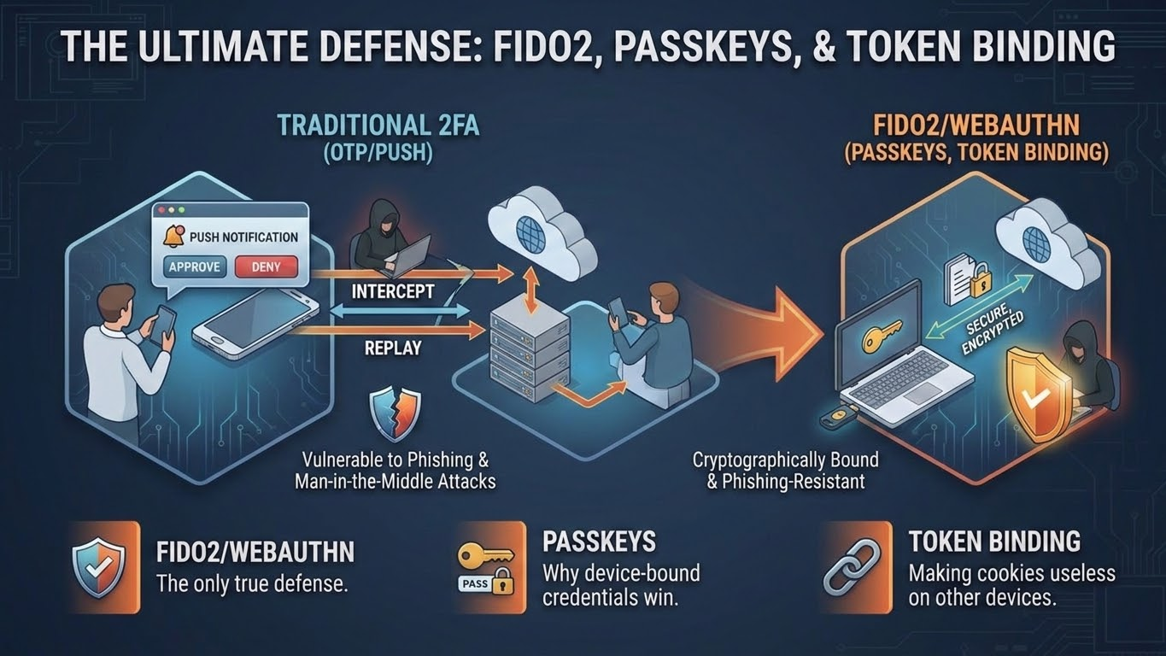
Notes:
The Ultimate Defense: FIDO2 & Origin Binding (7:00)
30:51 – 31:05 | Transition
But we aren't here to just admire the problem. We’re here to break the cycle. It’s time to move away from 'secrets' and toward the only thing that can actually shatter the adversary’s mirror."
31:05 – 31:27 | The Mirror Shatterer
If you take one thing home, let it be this: FIDO2 isn't just 'stronger MFA.' It changes the physics of the login. It is the 'Mirror Shatterer.' We have to stop asking users to be human firewalls and start letting the math do the work."
31:27 – 32:13 | Asymmetric Cryptography & Origin Binding
Every attack today works because a 'secret'—a password or a cookie—is sent across the wire. If it’s sent, it can be stolen. FIDO2 uses Asymmetric Cryptography. Your private key never leaves the secure chip on your hardware. It’s never sent to the server. But the 'Silver Bullet' is Origin Binding. When you tap that key, the browser tells the key: 'Sign this for microsoft.com.' If you’re on the proxy’s microsoft-security.com, the browser sees the difference. It tells the key the wrong name.
32:13 – 33:16 | The Cryptographic Refusal
The hardware key looks at its storage, sees that it has no credentials for the attacker’s fake domain, and it physically refuses to sign. No 'Proceed anyway' button. No user error. The 'Invisible Valet' can relay the request all day, but he cannot forge the signature. You’ve moved the burden of security from Dave’s tired eyes to the computer’s unyielding math. We’ve secured the 'Front Door.' Now, let’s lock the session to the machine.
[At the end of Slide 8, after explaining the Cryptographic Refusal]
So, FIDO2 is our shield for the 'Front Door.' It ensures the login itself is unphishable. But as security engineers, we know that 'Identity' doesn't end at the login. It lives in the session. Even with FIDO2 at the door, we still have millions of active cookies floating around our environments every day."
[Click to Slide 9]

Slide 9
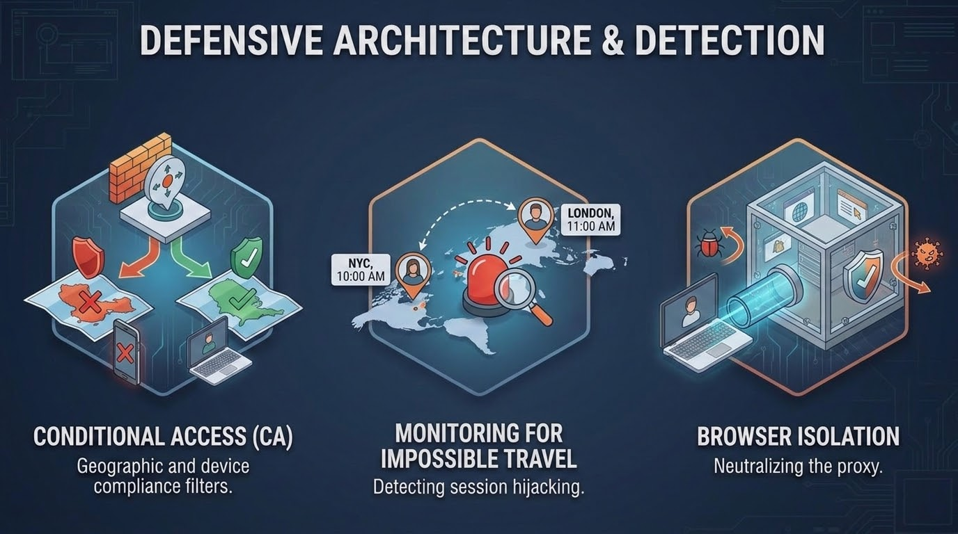
Notes:
Defensive Architecture: Token Protection (7:00)
33:16 – 33:28 | Transition
We need a way to make sure those cookies are just as unphishable as the login. We need to anchor that digital identity into the physical silicon of the machine.
33:28 – 34:13 | Locking the Cookie to the Silicon (DBSC)
We’ve seen how easy it is to 'teleport' a cookie. But through Device Bound Session Credentials (DBSC), we are turning that cookie into a 'Digital Brick' the second it leaves the laptop. The browser creates a key pair inside the TPM 2.0 chip on the motherboard. The session cookie is now cryptographically tied to that specific silicon. If our Valet steals that cookie and tries to inject it into a browser in another country, it fails. Why? Because the attacker’s laptop doesn't have the private key burned into Dave's hardware."
34:13 – 35:18 | The Heartbeat Check & CAE
This isn't a one-time check. The server now performs a 'Heartbeat' challenge. Every few minutes, it asks: 'Do you still have that TPM key?' If the proxy can't sign—which it can't—the session dies. Pair this with Continuous Access Evaluation (CAE). Traditional security only checks at login. CAE is a security guard that follows Dave around. If the system sees an 'Impossible Travel' alert, CAE kills the session globally in under 60 seconds. We aren't waiting for a timeout anymore; we’re reacting at the speed of light."
35:18 – 35:55 | The "Day 1" Reality
[Take a deep breath. Step toward the center of the stage. Look directly at the audience.]
We have gone completely under the hood. We’ve dismantled the engine of the proxy, unmasked the evasions of the bouncer, and built a cryptographic shield directly into the silicon of the motherboard.
But let’s be entirely honest with ourselves as security practitioners. Technical blueprints look beautiful on a conference screen, but insight without execution is just expensive trivia. The adversary isn't going to take a vacation because you attended a talk at BSides.
When you head back to your offices on Monday morning, the watering holes will still be waiting, and your users will still be clicking.
[Click to Slide 10]

Slide 10
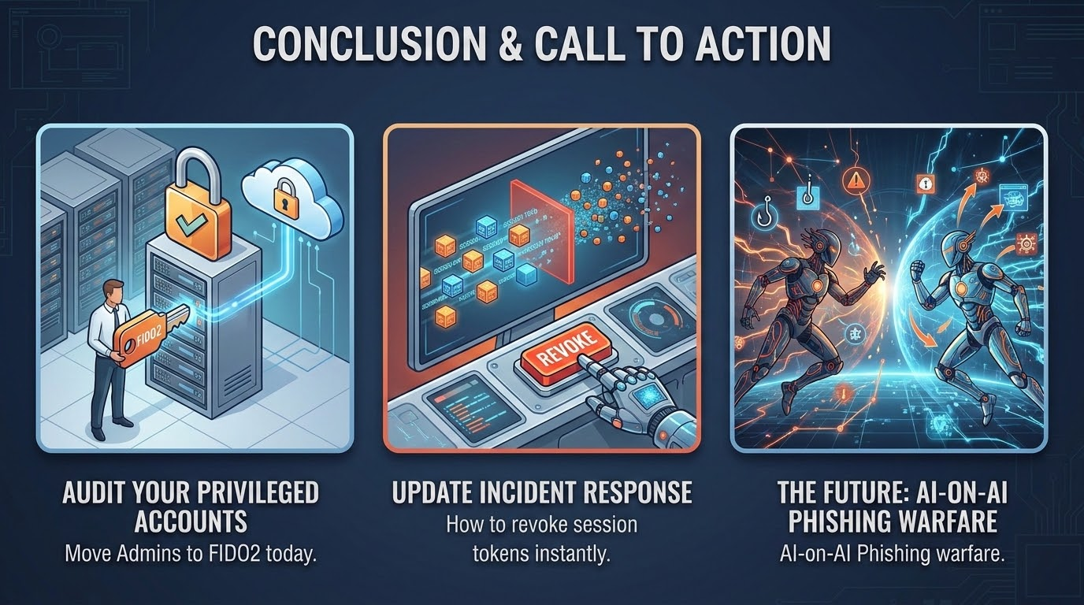
Notes:
35:55 – 36:19 | Architecture Over Awareness
We cannot train our way out of a systemic protocol failure. It is time to stop blaming Dave. Stop asking your engineers and your utility operators to act as human protocol analysts. Awareness has its place, but architecture is the definitive answer. You have the technical blueprints now. You know precisely how the adversary intercepts reality, and you know exactly how to lock them out of the topology. So let’s talk about your defensive blueprint for immediate operational eviction.
36:19 – 36:57 | The Monday Checklist
When you log into your environments on Monday morning, do three immediate things:
Audit your Admins. Check your high-value targets. If your Tier-0 Global Admins are not explicitly gated behind hardware-enforced FIDO2 keys, your front door is wide open to an identity clone.
2. Update your Incident Response Playbook. Erase the old legacy sequence. Step 1 is no longer 'Reset Password.' Step 1 must be 'Revoke All Active Sessions.' You have to structurally kill the active token topology before you modify the credential database.
3. Deploy Token Protection. Stop treating cookies as portable cash. Leverage the TPM 2.0 silicon chips you’ve already paid for on your enterprise motherboards and bind your identity infrastructure directly to the physical hardware."
36:57 – 37:12 | Final Word
The 'Same Watering Holes'—SharePoint, Teams, and Outlook—are not going anywhere. They will be there on Monday, and the adversary will be waiting inside them. But as of today, you possess the engineering blueprints required to drain them.
Thank you, BSides Harrisburg. My name is Joel Prentice, and I’ll be hanging out at the back of the room for any questions.

Slide 11
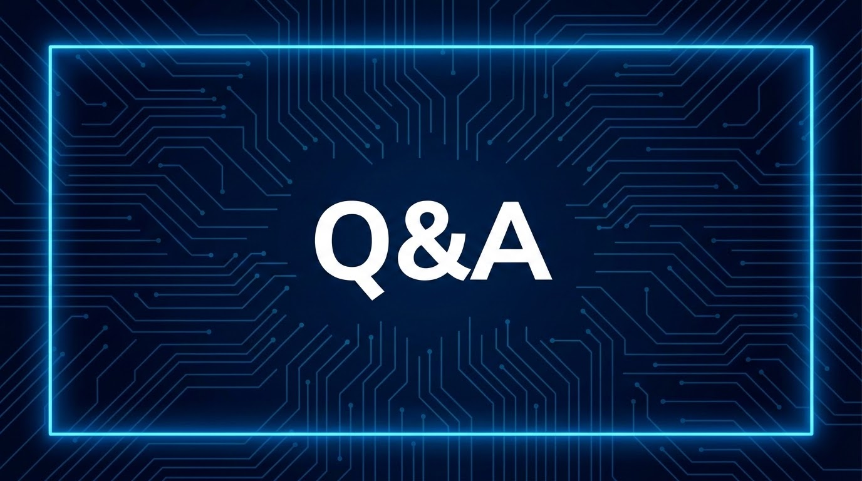

Notes:
1. The "Bypass" Questions (The Skeptics)
Question: "If I use FIDO2, can't the attacker just proxy the initial registration process?"
Answer: "Yes, if a user is tricked into registering a new key on a malicious site. This is why we push for Attestation. We can configure our IdP to only accept keys from specific, trusted hardware batches (like Yubico or Nitrokey), making it much harder for a software-based 'virtual' key to be registered by an attacker."
Question: "What about Token Protection (DBSC)? Can't an attacker just use a 'Remote Access Trojan' (RAT) to use the cookie while it's still on the victim's machine?"
Answer: "Exactly. DBSC stops Token Theft (teleporting the cookie), but it doesn't stop Session Hijacking via a RAT. However, a RAT is much 'louder' and harder to scale than a simple proxy link. We're forcing the attacker to move from a cheap, scalable web-attack to a high-cost endpoint-compromise attack."
2. The "Implementation" Questions (The Architects)
Question: "FIDO2 is great, but how do I handle my users who refuse to use a hardware key or have 'Legacy' apps?"
Answer: "It’s a journey. You start with your Tier 0 admins (Global Admins, Entra Admins). They are the high-value targets. For the rest of the fleet, we look at Microsoft Authenticator with Number Matching and GPS context, which isn't 'unphishable' but significantly raises the bar compared to a simple 'Approve' button."
Question: "Is Token Protection (DBSC) ready for prime time right now?"
Answer: "It's in 'Public Preview' for many Microsoft tenants. You can start testing it with Entra ID and Chrome/Edge today. The goal for Monday isn't to flip the switch for the whole company, but to start a Pilot Group for your most sensitive roles."
3. The "Detection" Questions (The SOC Analysts)
Question: "If the attacker is using a Residential Proxy, what logs should I actually be looking at to spot this?"
Answer: "Look at the User Agent strings and JA4 fingerprints in your sign-in logs. If you see 'Dave' suddenly change from his standard 'Windows/Chrome' fingerprint to something even slightly different—or if the 'MFA Method' used doesn't match the risk level of the application—that’s your smoking gun. Also, look for 'New Office Add-ins' or 'Mailbox Forwarding Rules' created immediately after a login."
4. The "Dave" Questions (The Human Element)
Question: "If we can't train our way out of this, should we stop doing Phishing Simulations?"
Answer: "We shouldn't stop, but we should reframe them. Stop testing if Dave 'clicks.' Start testing if Dave 'reports.' Our goal isn't a 0% click rate; it's a 100% reporting rate so the SOC can burn the infrastructure before the second person clicks."

